Slide 1


Introduction to App Development with .NET MAUI
Speaker Name
Speaker Title
name@email.com
@twitterAccount

Slide 2
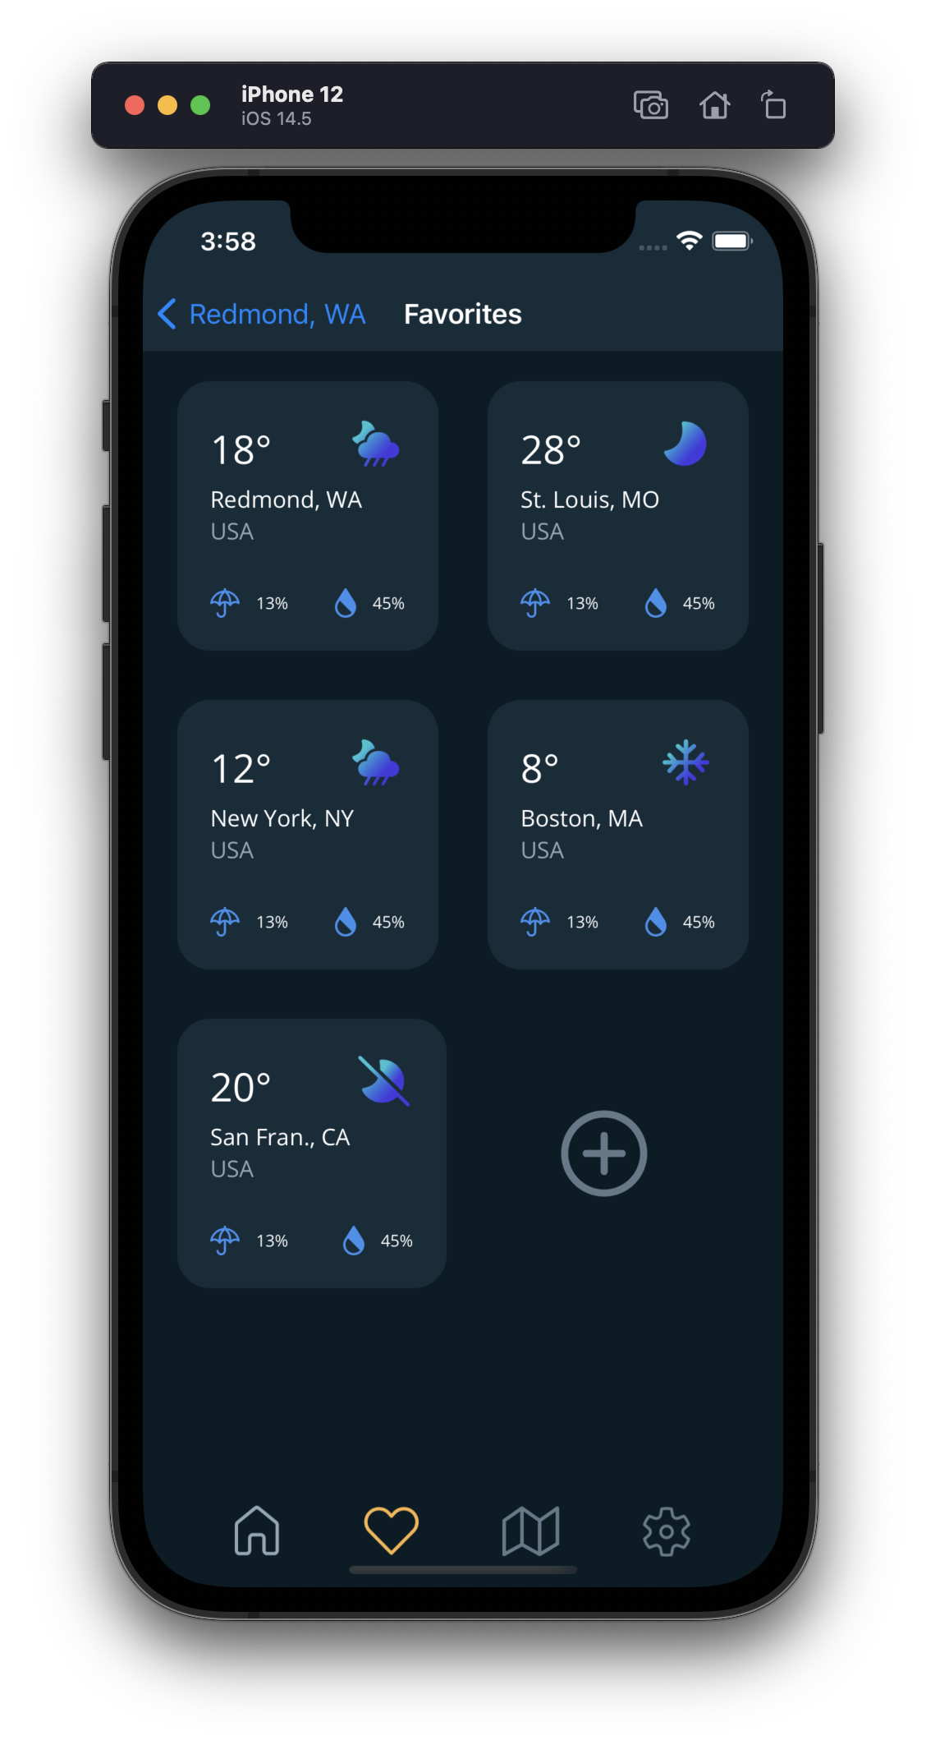
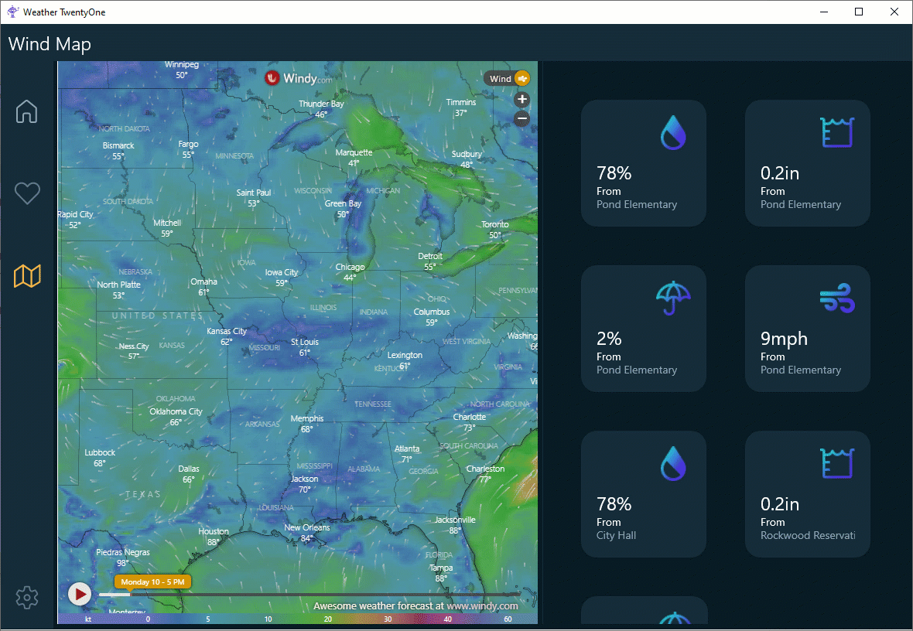
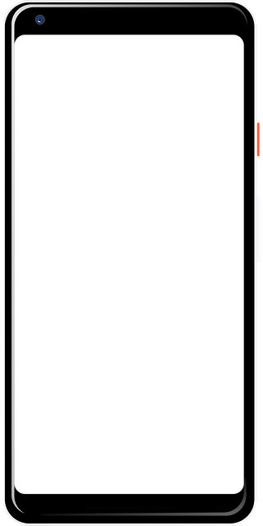
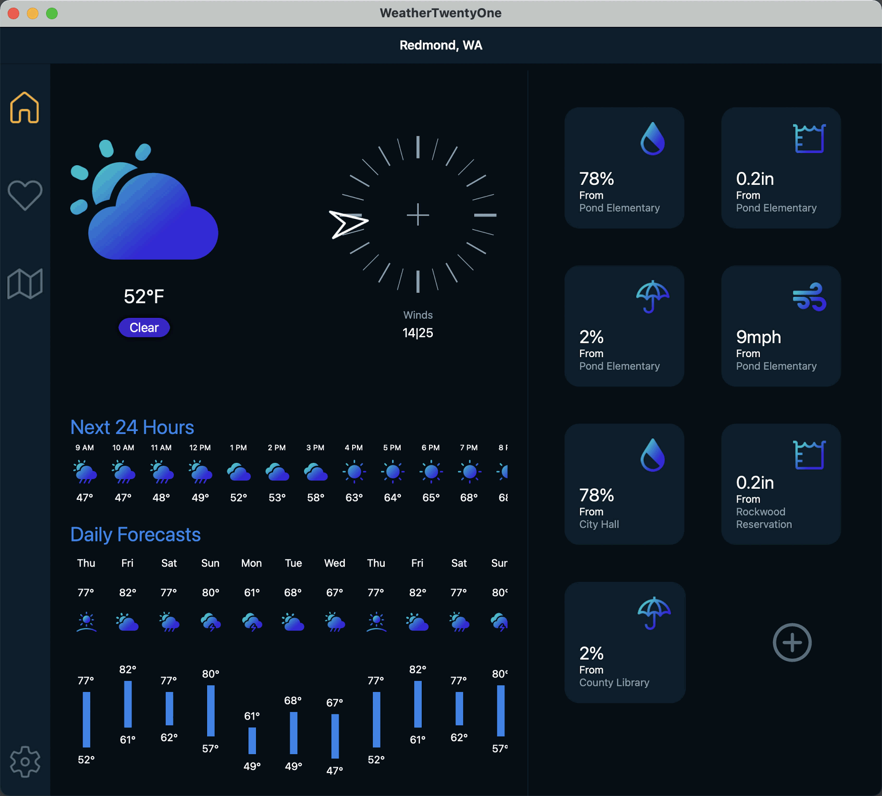
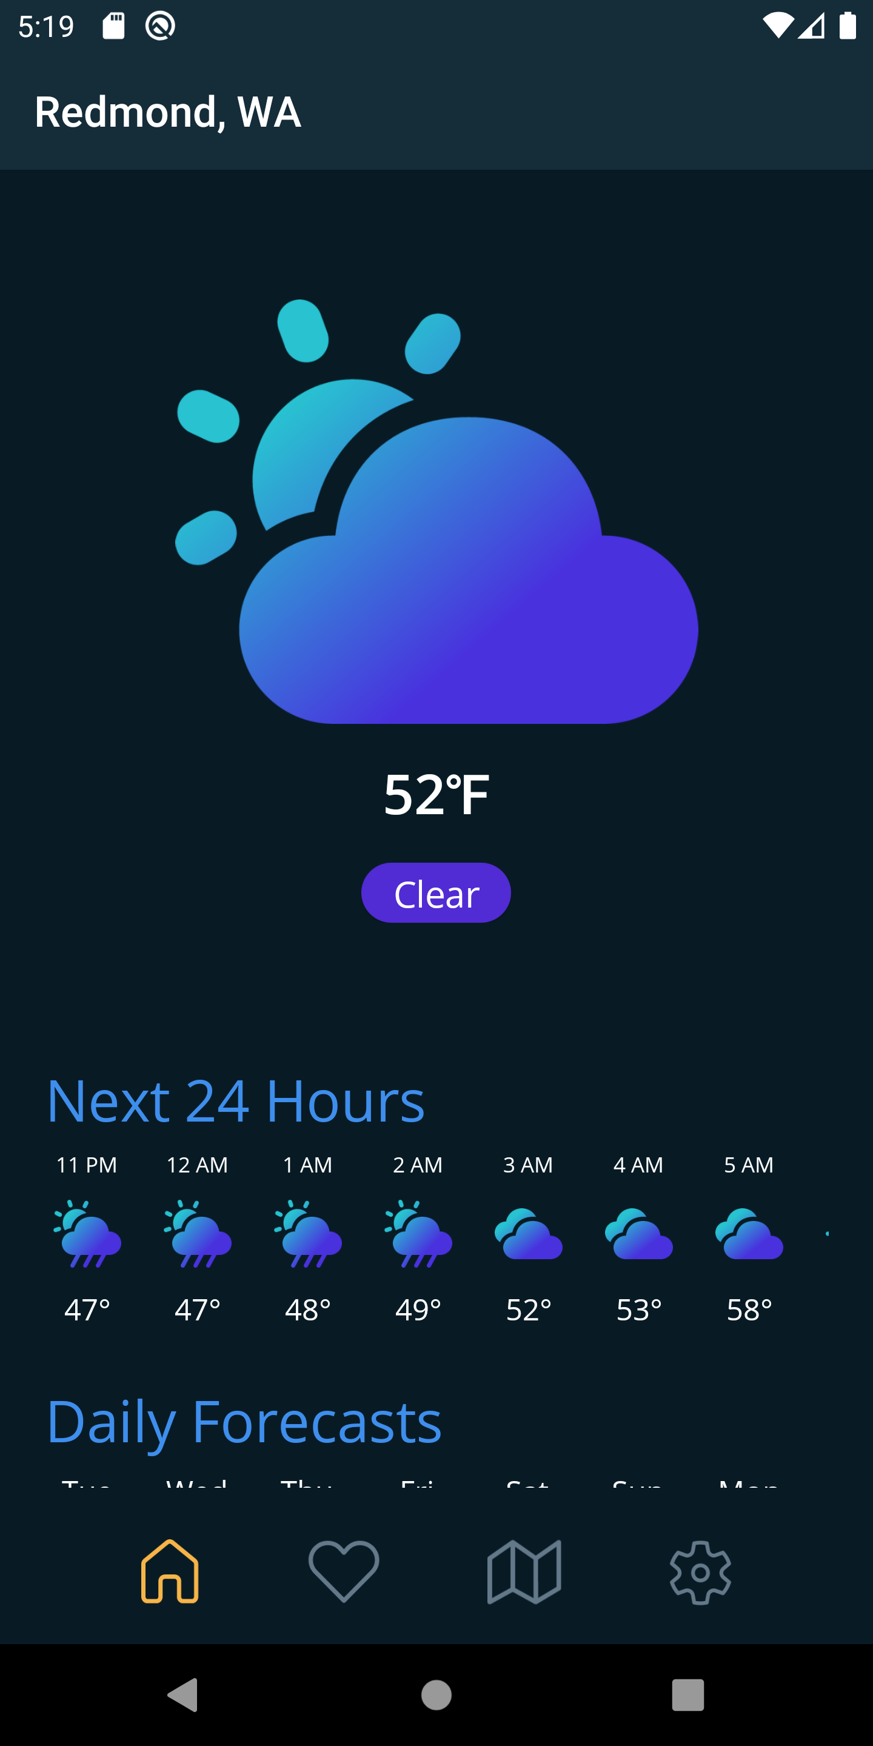
Agenda
.NET MAUI Overview
Project system improvements
Faster development with Visual Studio 2022
.NET MAUI Deep Dive

Slide 3


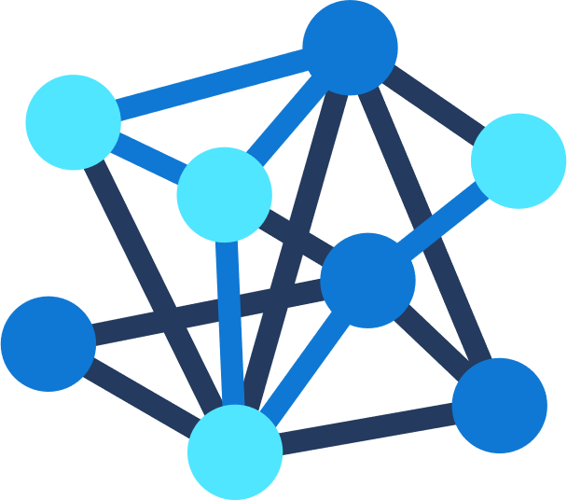





.NET – A unified development platform
ECOSYSTEM
TOOLS
NuGet
Visual Studio
CLOUD
WEB
DESKTOP
MOBILE
GAMING
IoT
AI
.NET 6
GitHub
Visual Studio for Mac
COMMON BASE LIBARIES/APIs
Components, tools, library vendors
Visual Studio Code
INFRASTRUCTURE
RUNTIME COMPONENTS
COMPILERS
LANGUAGES
CLI

Slide 4










Slide 5


Slide 6
.NET MAUI is the most productive way to develop native apps that perform great on any device that runs Android, iOS, macOS, or Windows from a single codebase.

Slide 7




Productive environment
Maximize code reuse
Native performance & integrations
Expansive ecosystem

Slide 8

.NET MAUI App Architecture
C#
C#
C#
C#
Shared Code
UI, Resources, Platform Features, & Business Logic

Slide 9




How does .NET MAUI work?
.NET Multi-platform App UI
.NET for Android
.NET for iOS / Mac Catalyst
WinUI
.NET Base Class Library (BCL)
App Code
.NET Runtime
Android
iOS
macOS
Windows
iOS
macOS
Notes:
How is it native?
Everything starts with your app code. This is where you want to spend all your time being productive. And you want to deliver your app on 1+ devices
The first layer of the technology cake is the native platform SDK. This what Google, Android, and Microsoft ship for those platforms
So how do we get from our .NET app code to those platforms and running on devices?
First we need something that can run .NET code: the .NET Runtime. (Yes, it uses MonoVM on mobile and Mac, and CoreCLR on Windows, but that’s not terribly important because...)
Next we need a common .NET API we can write our code against, and that’s the Base Class Library (BCL). New in .NET 6 app runtimes use the same BCL.
To use .NET against native platform SDKs we need a .NET representation of them. We do this via binding a .NET API and implementation to the native API. When you call a native method from C#, it’s just as if you had done it from Obj-C, Swift, Java, Kotlin, or C++.
The final layer of the cake that really makes it delicious is .NET MAUI. .NET MAUI provides a rich library of controls, layouts, and services that work across all of the platforms supported, so you need only master one API to get native apps.
(next slide) With .NET MAUI, all of that complexity is delivered in a single framework that gives you access to it all.

Slide 10
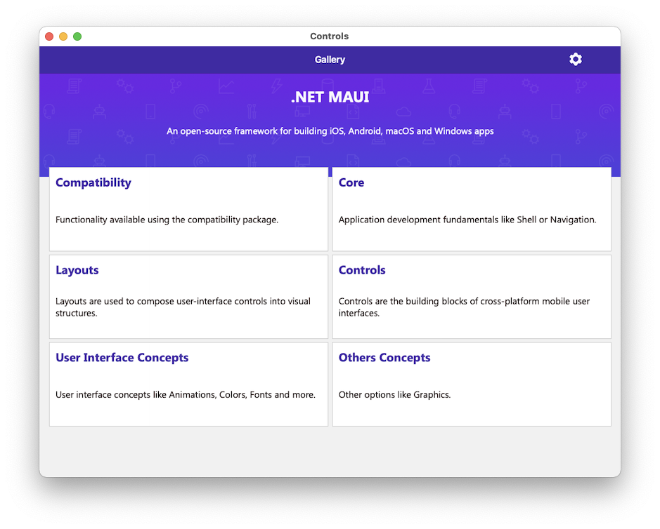
Rich Library of Controls
40+ Controls
Navigation
Flyout Menu
Bottom Tabs
Top Tabs
Hierarchical
Adaptive layouts
Right-to-Left
Semantic Accessibility

Slide 11




UIActivityIndicator
ProgressBar
UISlider
SeekBar
ActivityIndicator
Slider

Slide 12
Controls
CarouselView
CollectionView
RefreshView
IndicatorView
Checkbox
RadioButton
ImageButton
SwipeView
ActivityIndicator
BoxView
Button
DatePicker
Editor
Entry
Image
Label
ListView
Map
OpenGLView
Picker
ProgressBar
SearchBar
Slider
Stepper
TableView
TimePicker
WebView
EntryCell
ImageCell
SwitchCell
TextCell
ViewCell
Path
Ellipse
Polygon
Rectangle
Line
Polyline
Notes:
You have more than 40 controls, layouts, and pages to mix and match from.
These are all of the controls you have out of the box, you can of course create your own.
What is unique is you get the native control and have access to it.

Slide 13
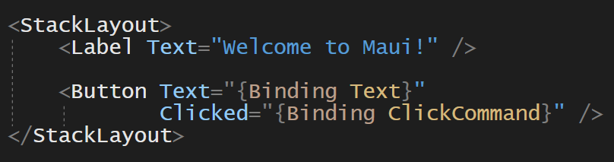
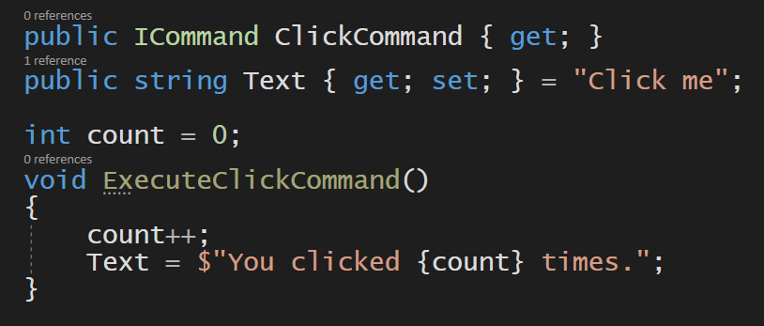
Building UI in .NET MAUI
Optimized for XAML, C#, and MVVM

Slide 14

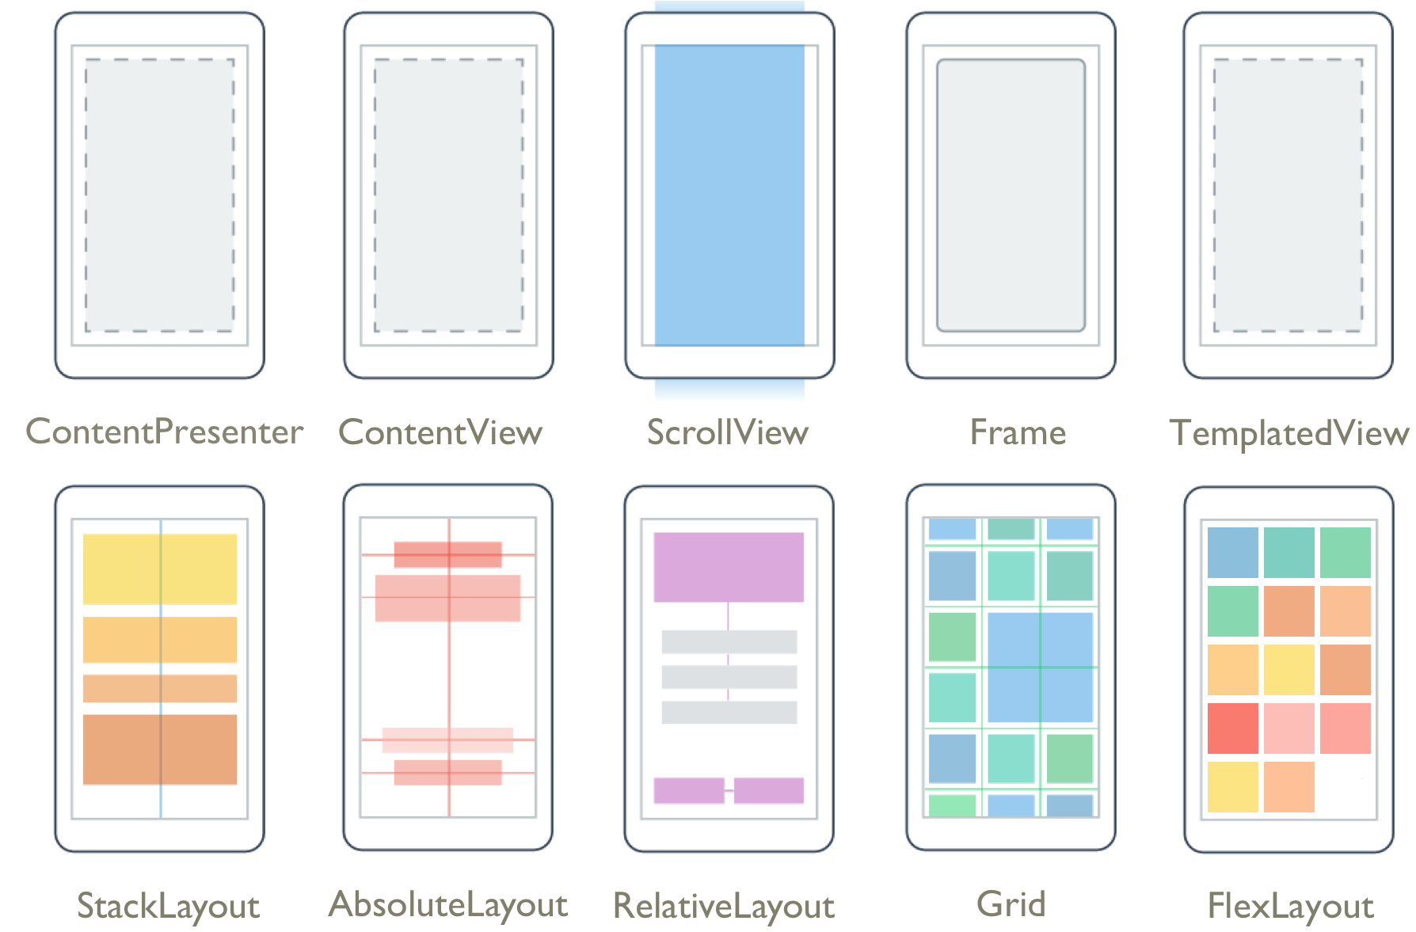
Layouts
Pages
Content
Flyout
Navigation
Tabbed

Slide 15
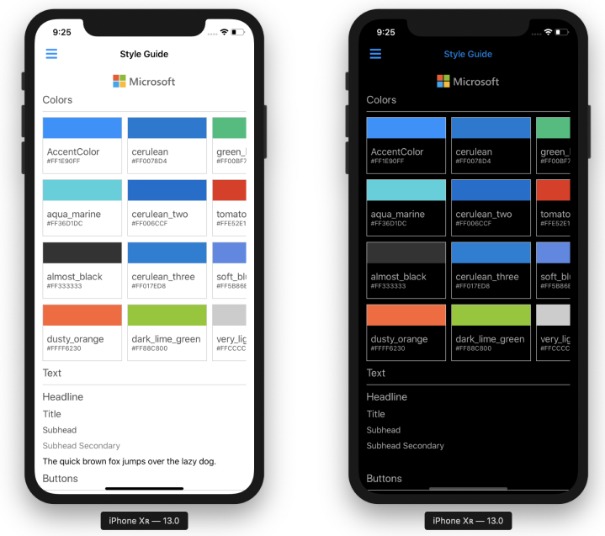
Abundant Styling Options
Themes for dark and light
Static and dynamic styles
XAML and CSS
Visual State Manager
Custom fonts and font icons
Images from many formats including SVG

Slide 16
Easily customize controls
#if ANDROID
Handlers.EntryHandler
.EntryMapper[nameof(IEntry.BackgroundColor)] = (h, v) =>
{
(h.NativeView as global::Android.Views.Entry).UnderlineVisible = false
};
#endif
#ifdef if platform specific
Access the handler from anywhere
Dictionary of all props
Notes:
The new handler architecture makes it easy to hook into any property and add/modify behavior right in .NET MAUI
In this example we hook into the background color and change the Android underline visibility on the Entry.
We could also, with a little more effort, add a custom property mapping specific to the underline and implement that with almost identical code.

Slide 17
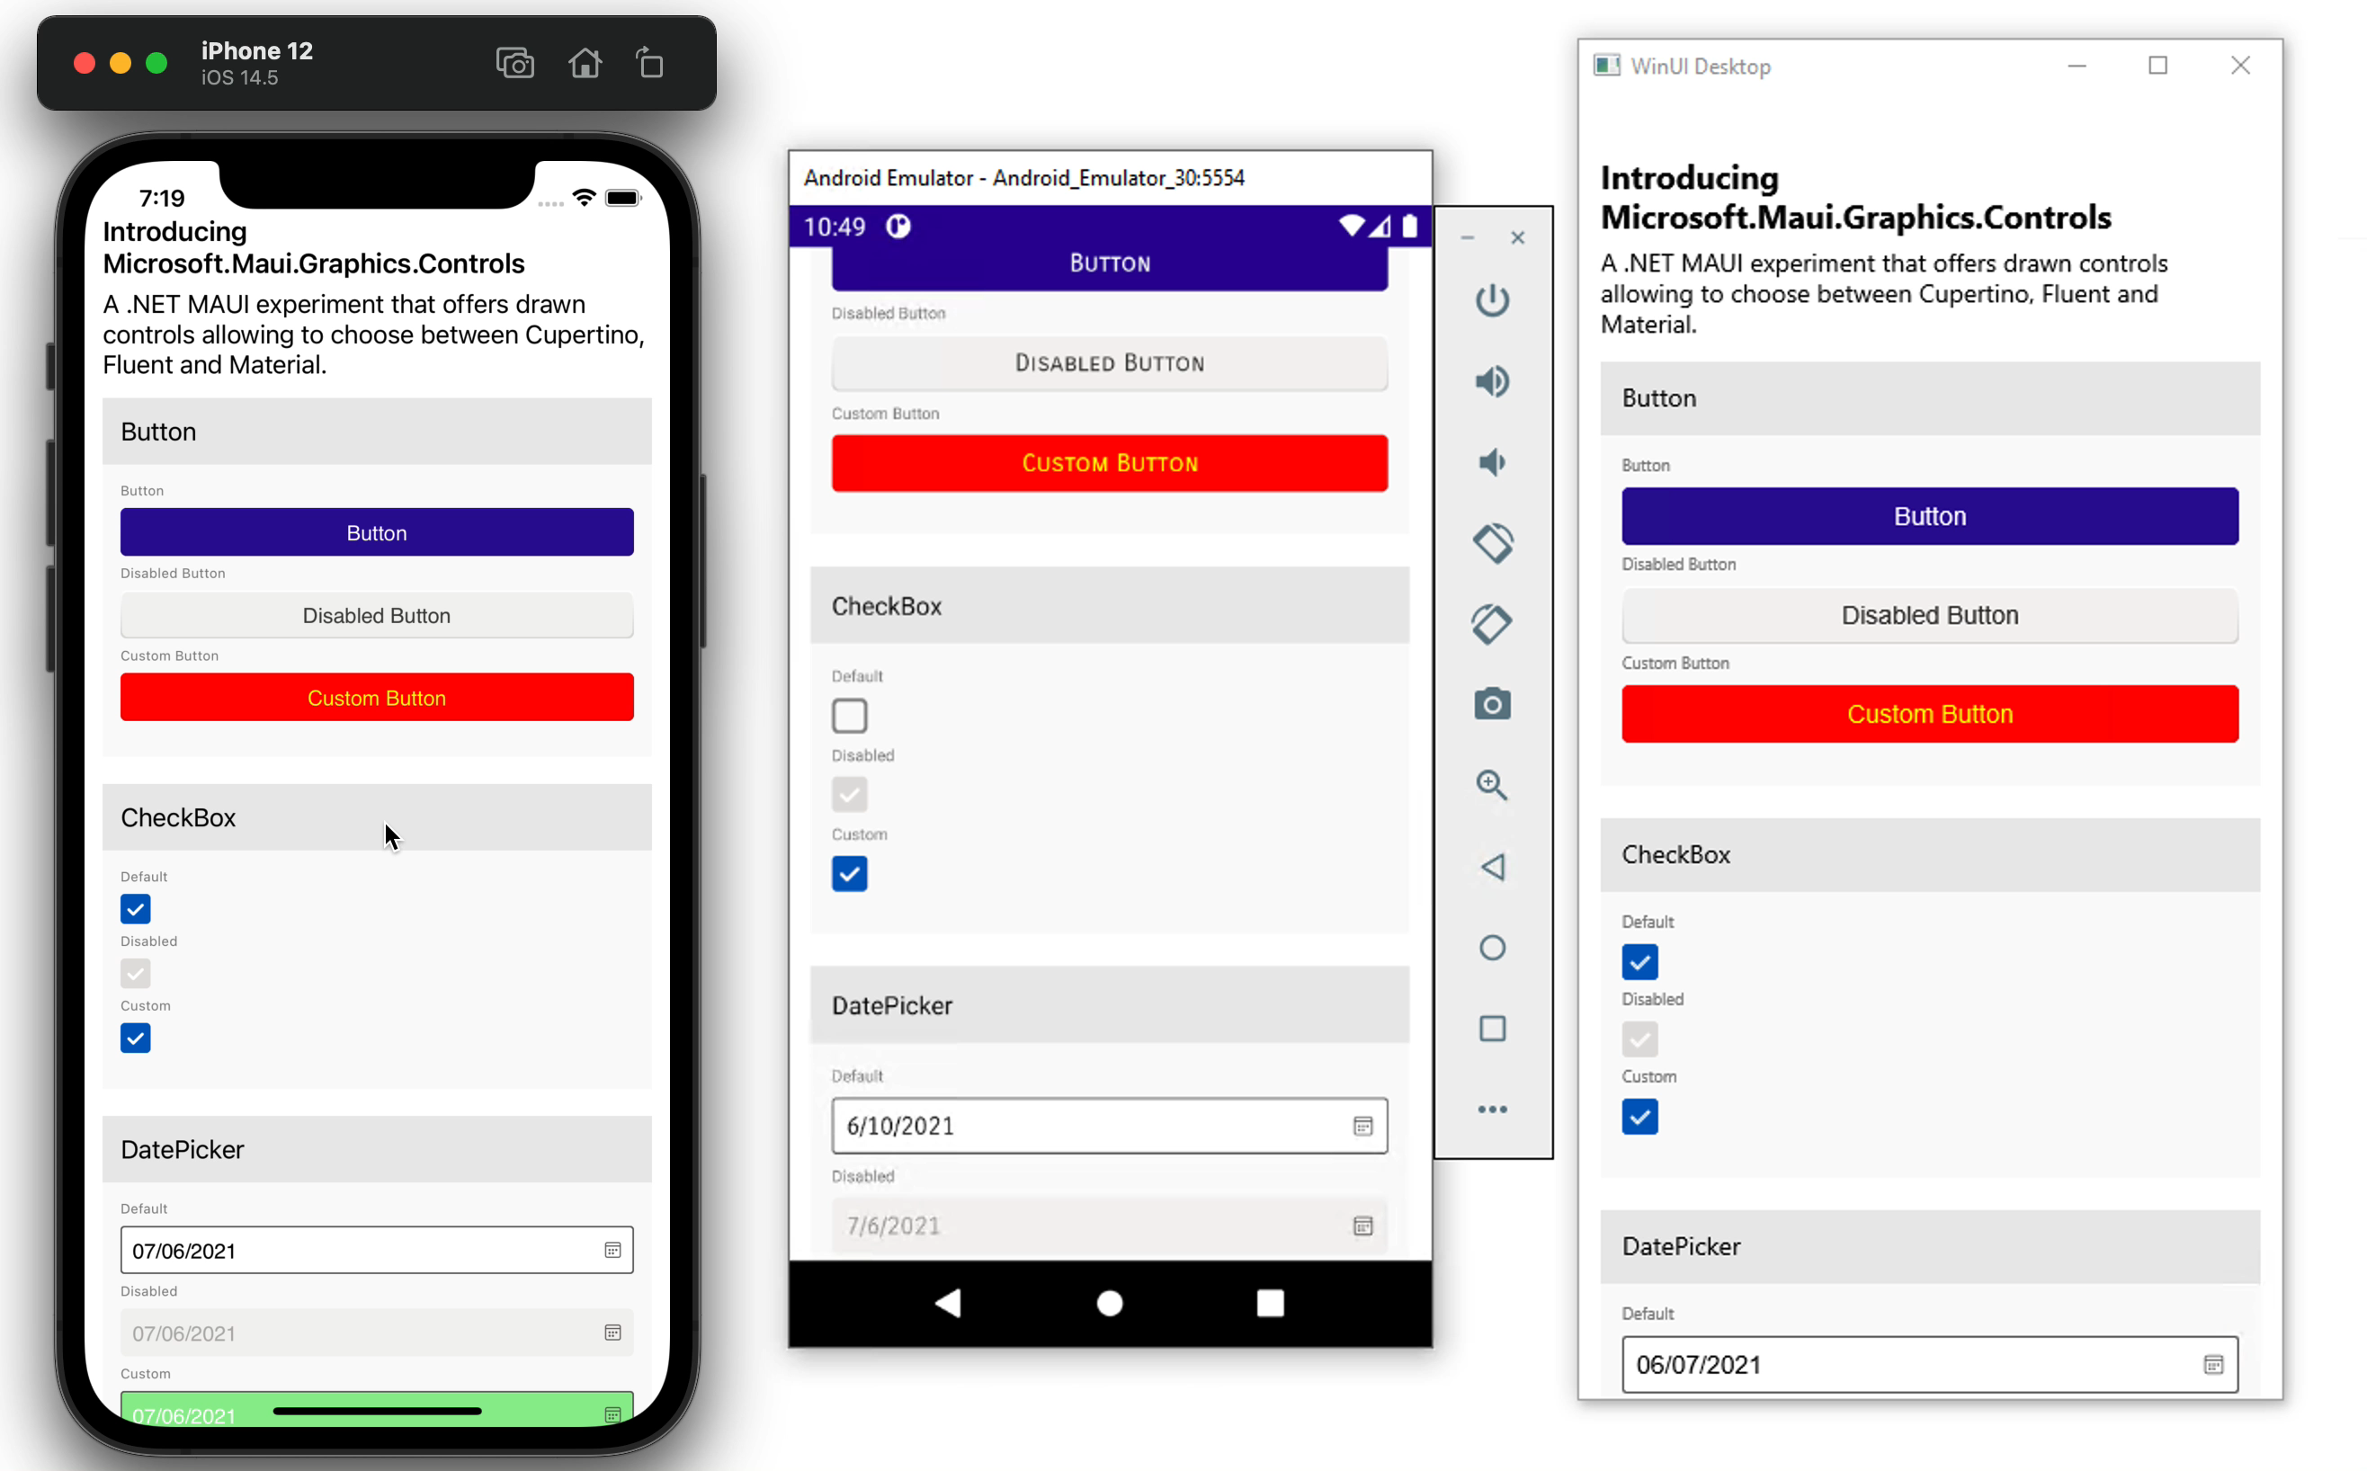
Pixel Perfect UI with Maui.Graphics
Native graphics or SkiaSharp
Fluent and Material design

Slide 18
Project System Improvements
Optimized for Cross-Platform Workflows

Slide 19
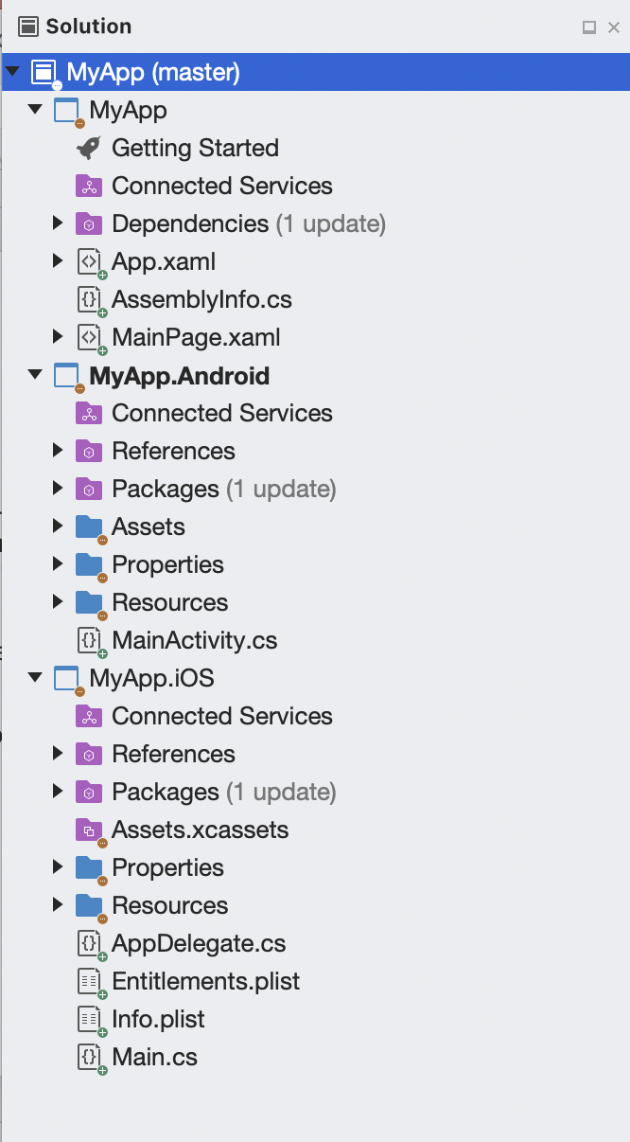
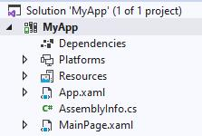
Single Project
Productivity
Reducing multiple projects to a single project alleviates several points of friction when developing apps that target multiple platforms.
Images
Fonts
Platform code
Splash screen
Notes:
One project can now publish to any of the platforms supported.
Images are optimized at build time for the multiple densities of screens required across all the platforms you target.
Fonts are registered in one location for every platform, and you can alias the name as you desire.
Platform code can all live within this one, multi-targeted project.
Splash screen support makes it easy to declare a visual asset (PNG or SVG for example) and a background color.

Slide 20
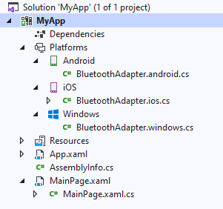
Single Project
Productivity
Reducing multiple projects to a single project alleviates several points of friction when developing apps that target multiple platforms.
Images
Fonts
Platform code
Splash screen

Slide 21
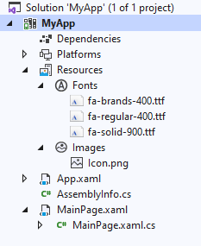
Single Project
Productivity
Reducing multiple projects to a single project alleviates several points of friction when developing apps that target multiple platforms.
Images
Fonts
Platform code
Splash screen

Slide 22
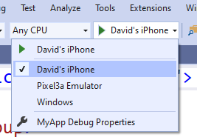
Single Project
Productivity
Reducing multiple projects to a single project alleviates several points of friction when developing apps that target multiple platforms.
Images
Fonts
Platform code
Splash screen

Slide 23
Faster Development
Optimized Inner-loop

Slide 24

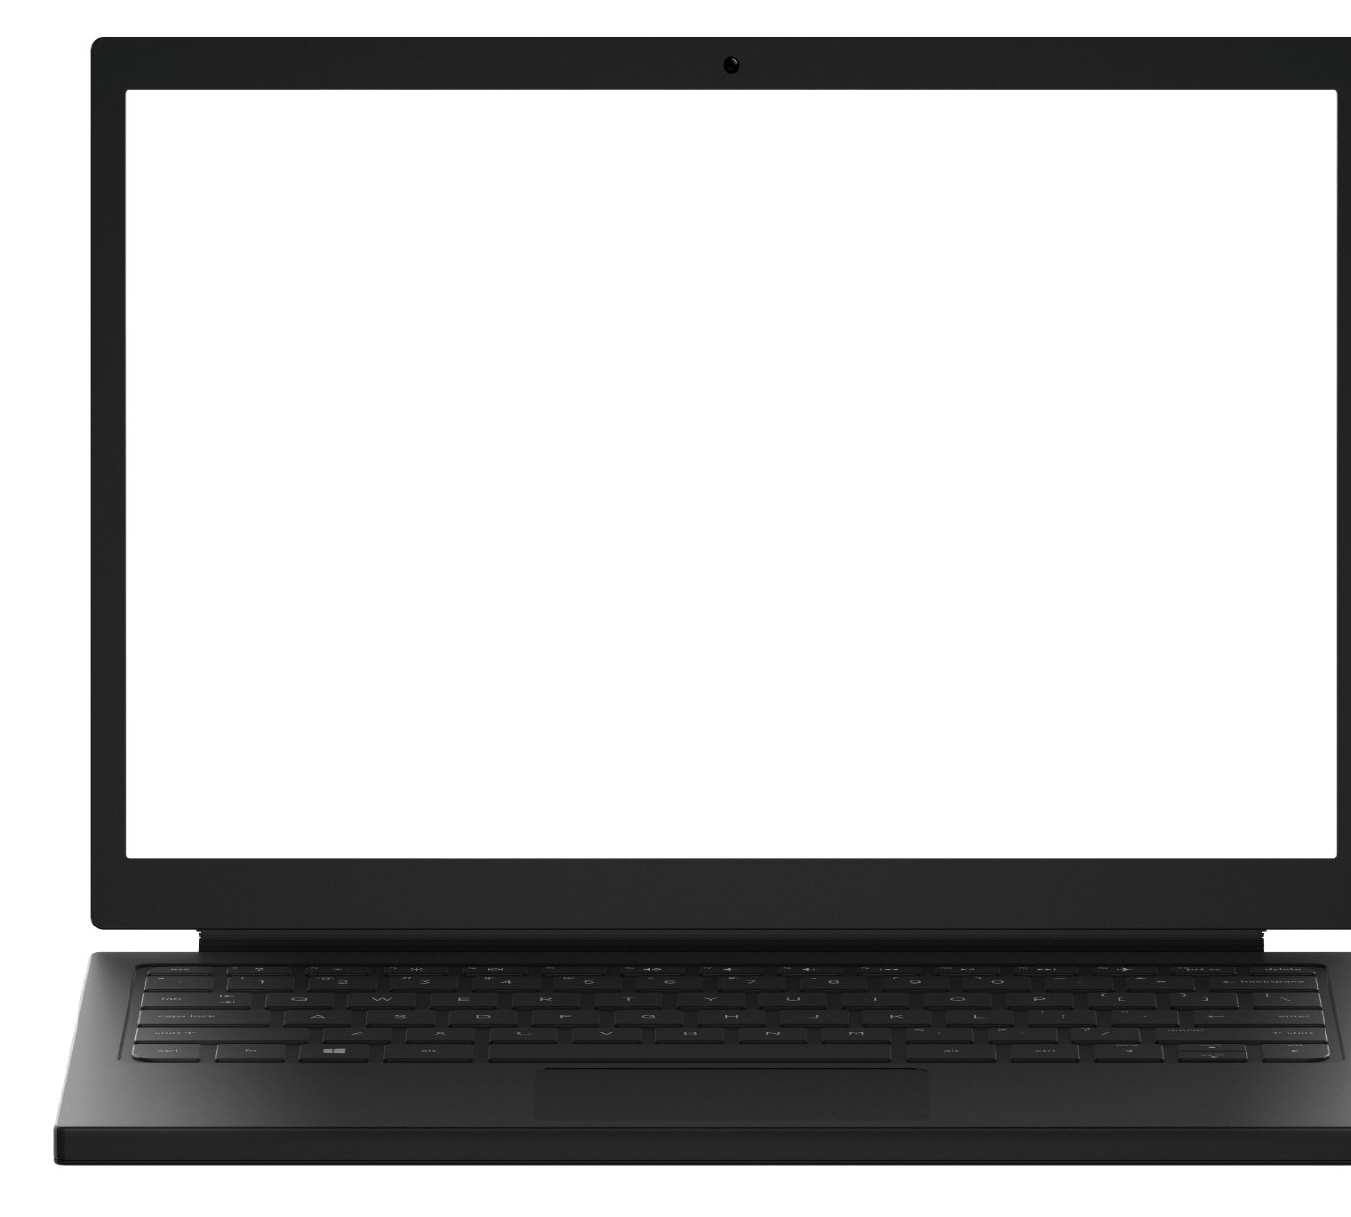
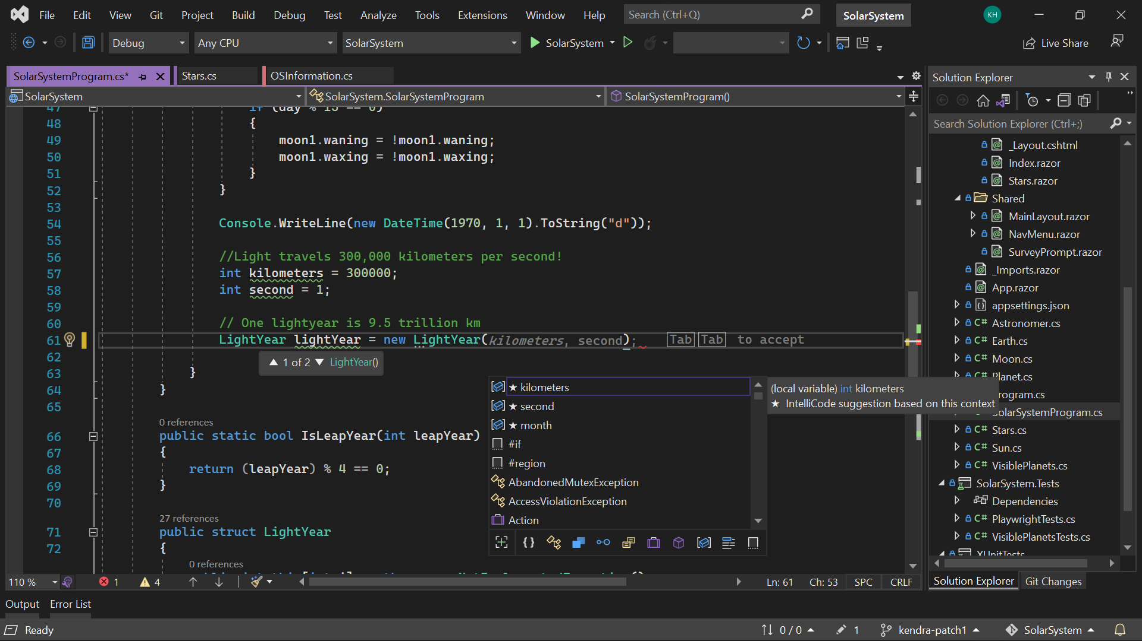
Visual Studio 2022
Modern development
Build innovative, modern apps using .NET 6, GitHub and Azure with integrated tooling
Personal and team productivity
Live Share, Hot reload everywhere, Web live preview, IntelliCode, enhanced debugging and testing tools
Scale to projects of any size
An optimized, modern UI built on 64-bit architecture to support the largest, most complex codebases and workflows
VisualStudio.com/download

Slide 25

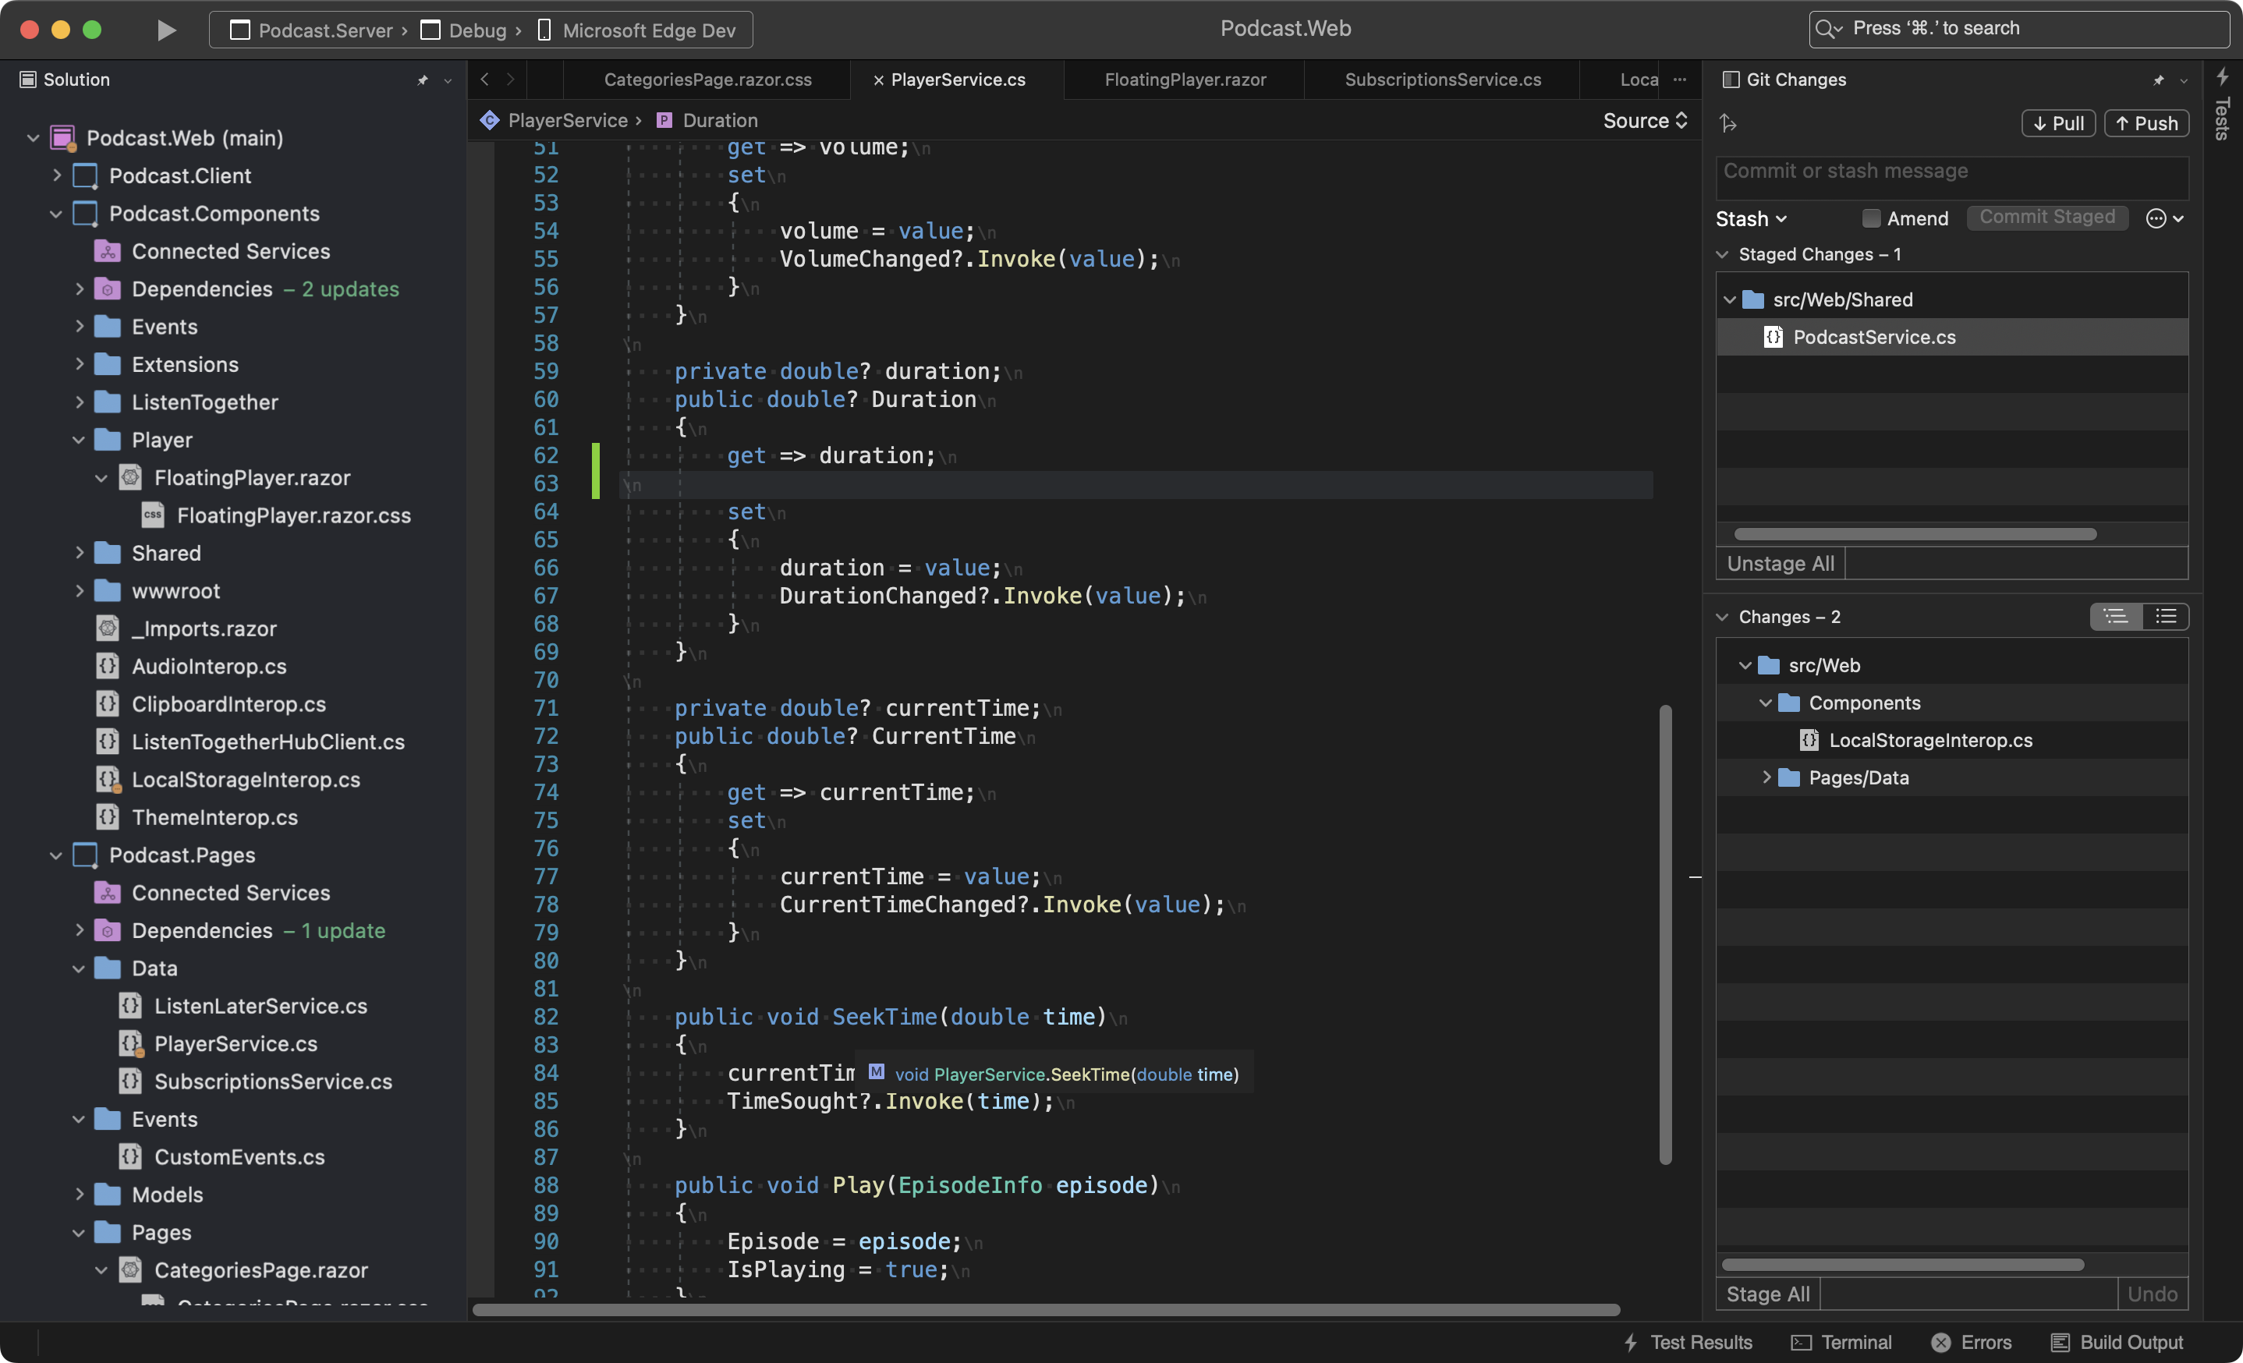
Visual Studio 2022 for Mac
Fast and Fluid
Focused on performance with over 100 user reported issues fixed; running on .NET 6 and with native support for Apple’s M1 processor
Modern macOS UI
A rewritten UI, using native macOS Cocoa APIs. With native theming, full screen support, and macOS accessibility tooling.
Support for .NET 6
Build for the web, cloud, and mobile, using .NET 6.
https://aka.ms/vsmac-preview

Slide 26
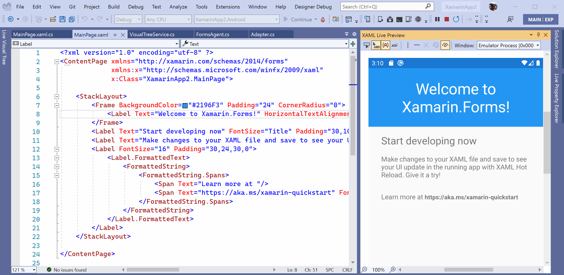
Code it Live
Productivity
Whether XAML or C#, you can code while debugging your application and see the changes instantly. No more stop-edit-rebuild for simple tweaks.
When you do something more complex, Visual Studio will prompt you to rebuild.
C#
CSS
Razor
XAML
Notes:
Code live whether it’s C#, CSS, Razor, or XAML. Less time building and more time coding.
In a future Visual Studio 2022 release you’ll also be able to see your app right inside the IDE where you can inspect elements and set UI guides.
(this is showing Xamarin.Forms and will be replaced with a .NET MAUI example. Same technology)

Slide 27
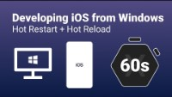
Windows and iOS
Productivity
Connect any iOS device directly to Windows and start coding in Visual Studio 2022. That’s it!
Changes are pushed from Visual Studio directly to the app running on device, no Mac build host required.
When you’re ready to publish and distribute, connect a Mac or use a cloud service to finish the job.
Notes:
Aka “Hot Restart” enables you to use your Apple developer account, a Windows dev machine, and any iOS device to build and test iOS apps.

Slide 28
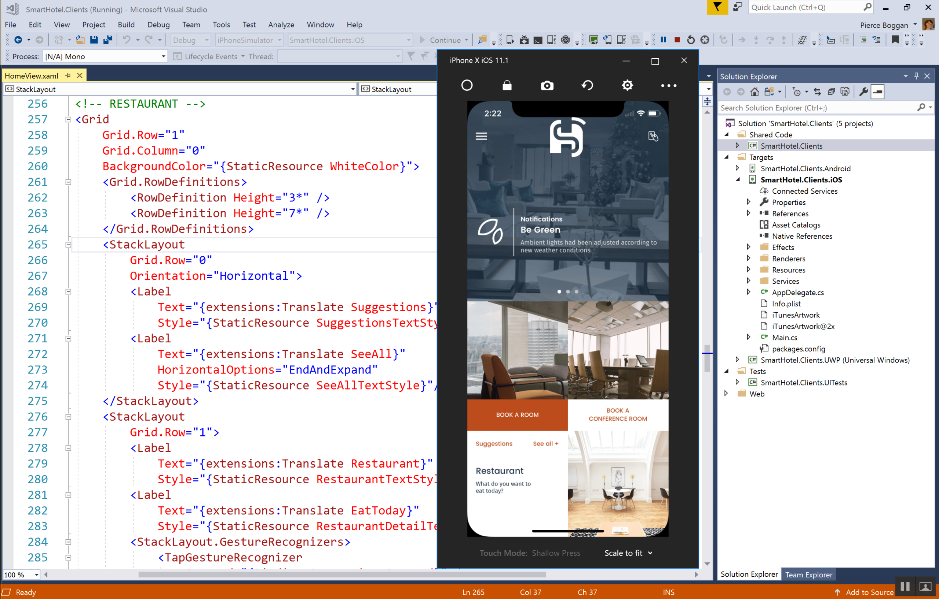
Remote iOS Simulator
Productivity
For more Apple features, connect your Visual Studio 2022 on Windows to a Mac on your local network. With this you get:
Native Xcode builds over SSH
Remote simulator
Touchscreen support
Notes:
Code live whether it’s C#, CSS, Razor, or XAML. Less time building and more time coding.
In a future Visual Studio 2022 release you’ll also be able to see your app right inside the IDE where you can inspect elements and set UI guides.
(this is showing Xamarin.Forms and will be replaced with a .NET MAUI example. Same technology)

Slide 29
And beyond
More ways to use .NET MAUI

Slide 30

Cross-Platform APIs
Sms
Secure Settings
Preferences
Flashlight
Clipboard
Gyroscope
Magnetometer
Geolocation
Phone Dialer
Device Display Info
Email
Device Info
Battery
Compass
Accelerometer
Screen Lock
Data Transfer
Text to Speech
Geocoding
File System
Connectivity
Vibration

Slide 31
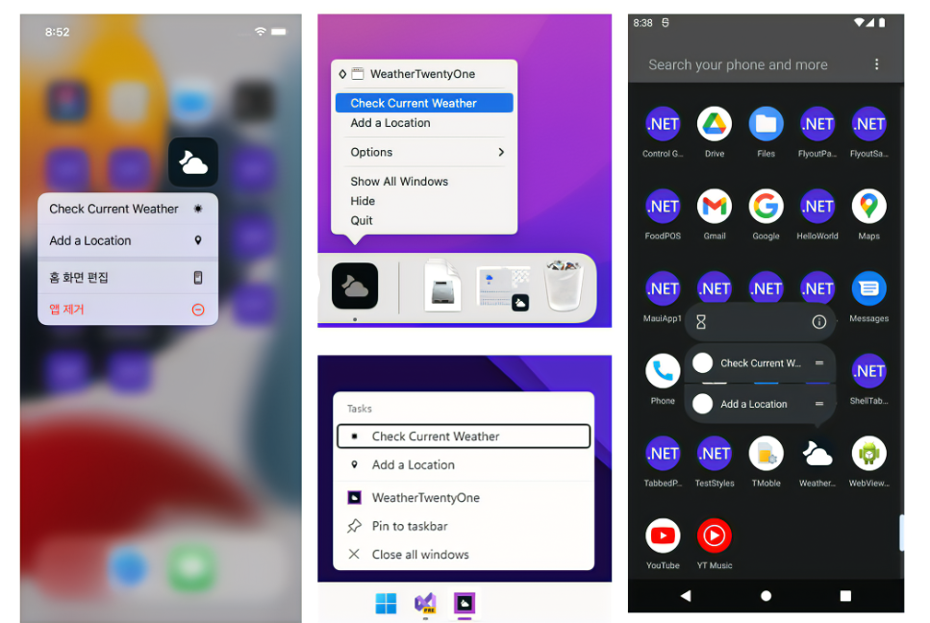
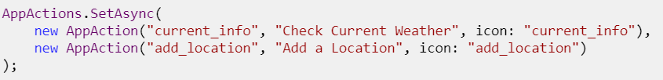

Slide 32
Geolocation Example
// Get cached location, else get real location.
var location = await Geolocation.GetLastKnownLocationAsync();
if (location == null)
{
location = await Geolocation.GetLocationAsync(new GeolocationRequest
{
DesiredAccuracy = GeolocationAccuracy.Medium,
Timeout = TimeSpan.FromSeconds(30)
});
}

Slide 33
Geolocation Example
// Register service
builder.Services.AddSingleton<IGeolocation, GeolocationImplementation>();
// Inject service
IGeolocation geolocation;
public MyViewModel(IGeolocation geolocation)
{
this.geolocation = geolocation;
}

Slide 34
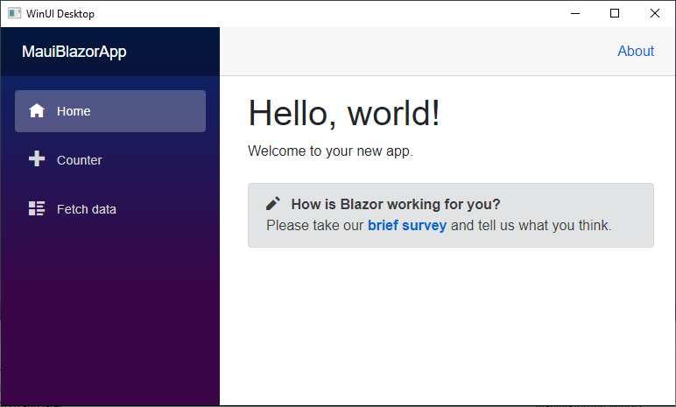
Blazor Hybrid
Bonus
Mix your Blazor app and .NET MAUI to create seamless hybrid experience on desktop and mobile.
BlazorWebView hosts web app
Access any .NET MAUI API from Razor
Combine web UI and native UI
Low memory footprint

Slide 35

Hybrid Architecture - .NET MAUI & Blazor
C#
C#
C#
C#
C#
Shared Blazor Components
Shared Business Logic

Slide 36
.NET brings rich choices for devs and dev teams
Blazor
Blazor Hybrid
(Blazor + .NET MAUI)
.NET MAUI
Reach
Power
Site
PWA
Native App
with WebView
Native App
Web
Hybrid
Native
Notes:
This is a sliding scale of choosing how much or how little native vs web you want to use

Slide 37
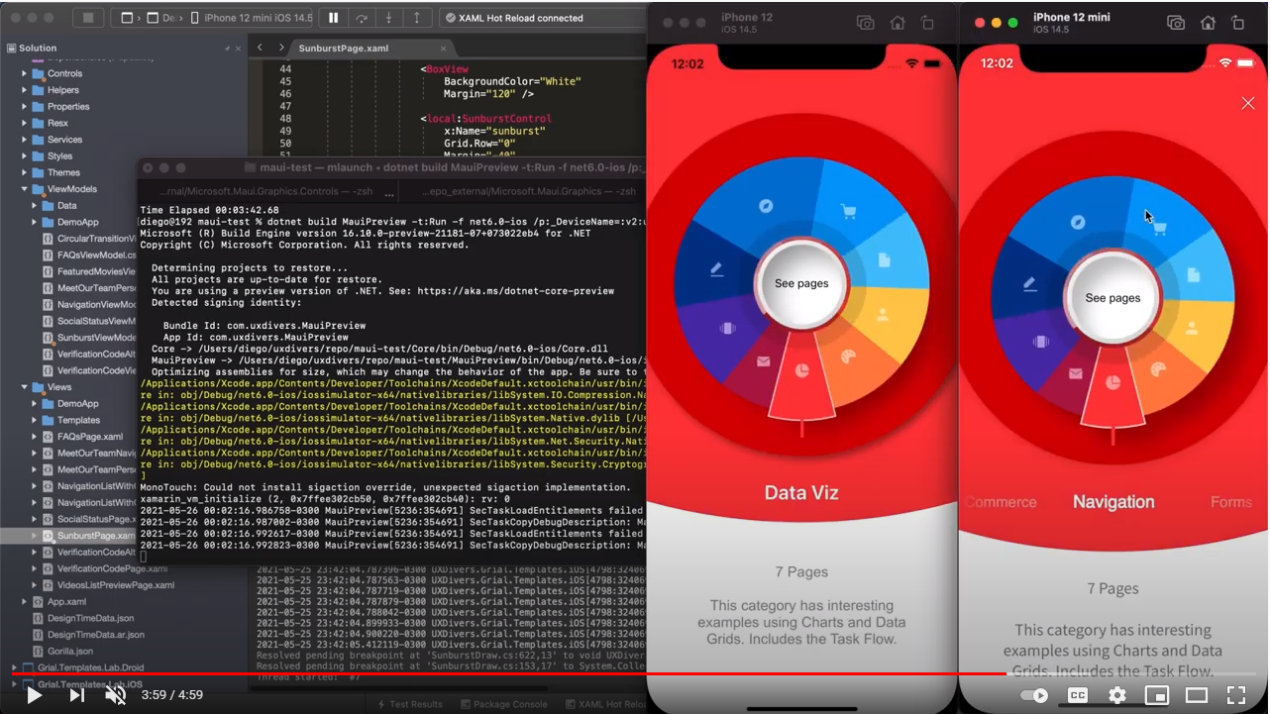
Microsoft.Maui.Graphics
Bonus
What .NET MAUI is to platform UI toolkits, Maui.Graphics is to platform graphics rendering.
Canvas with primitive drawing types
Fonts
Attributed text
Bitmaps
PDFs
Unified Color types
Broad platform support
SkiaSharp supported

Slide 38
.NET MAUI Ecosystem

Slide 39
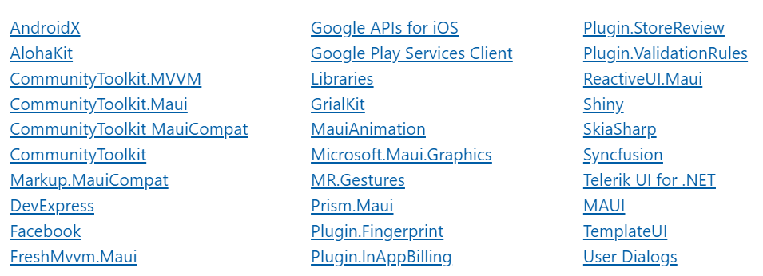
Core Community Packages Ready!

Slide 40
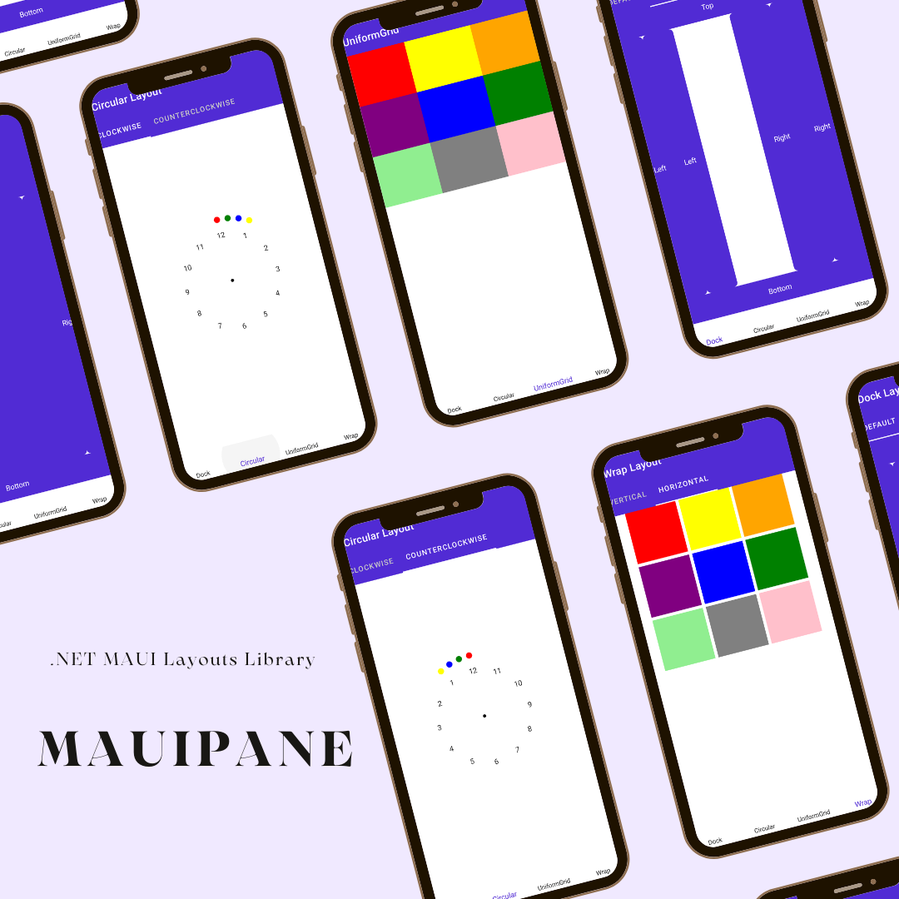
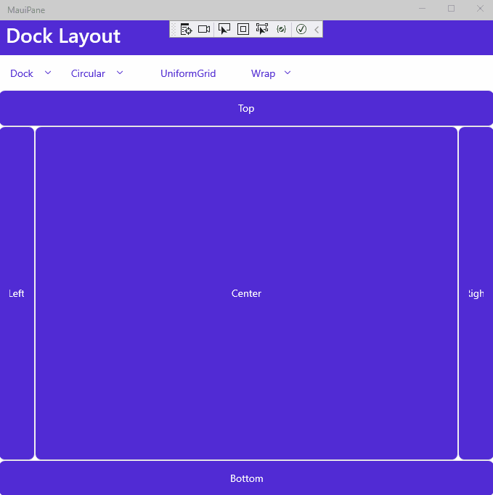

Slide 41
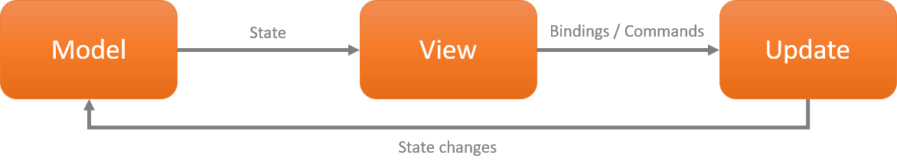
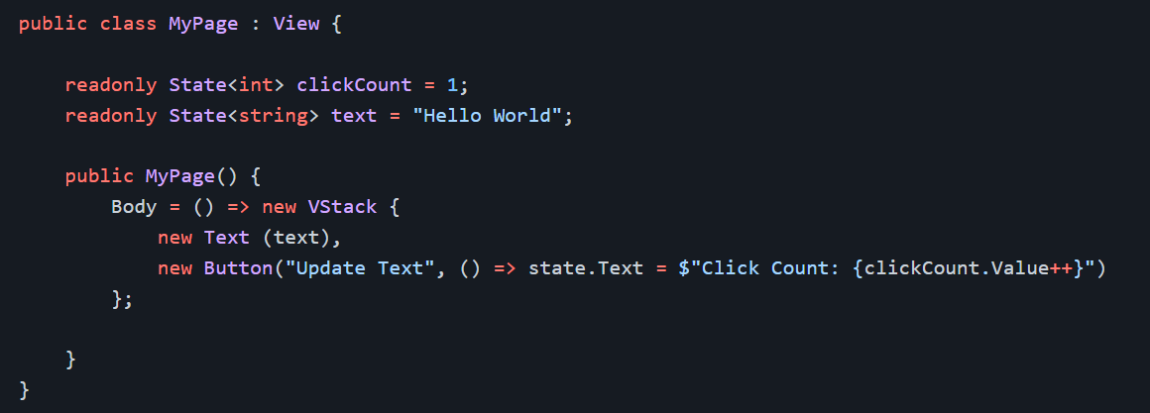
Comet ☄️

Slide 42






Component Vendors
Notes:
And, our partners building controls make much of this possible, creating gorgeous pre-built UI controls for you to drop right in to your app

Slide 43


Slide 44
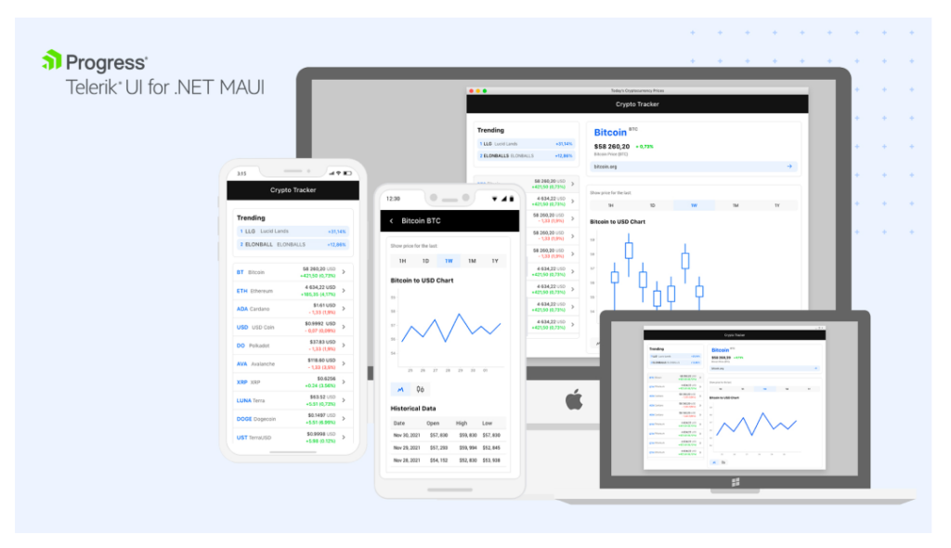

Slide 45
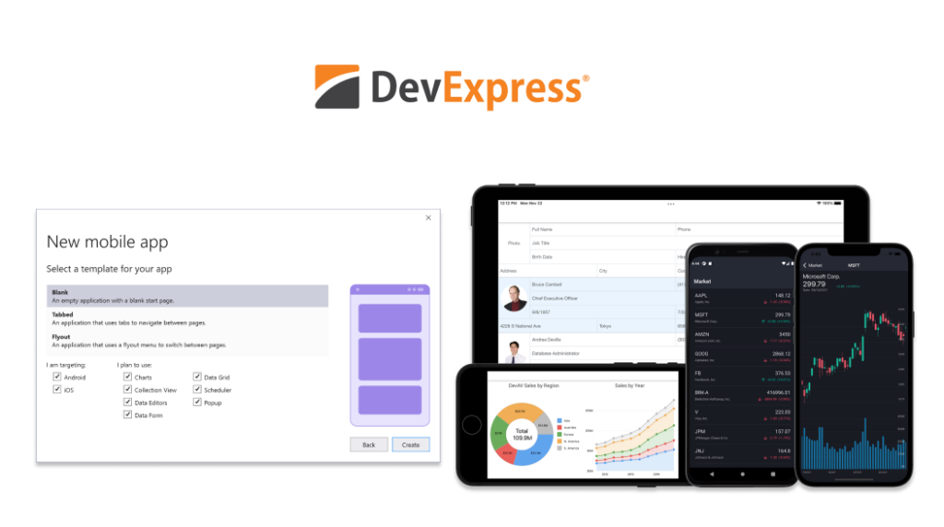

Slide 46
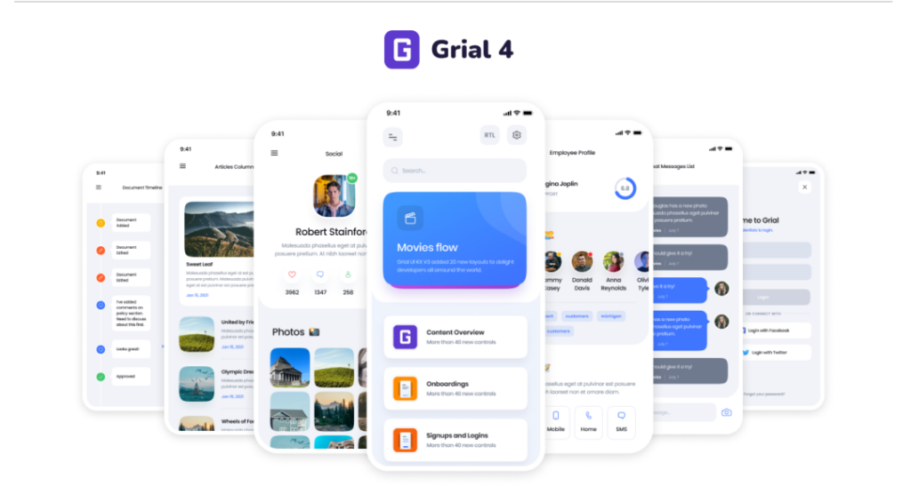

Slide 47
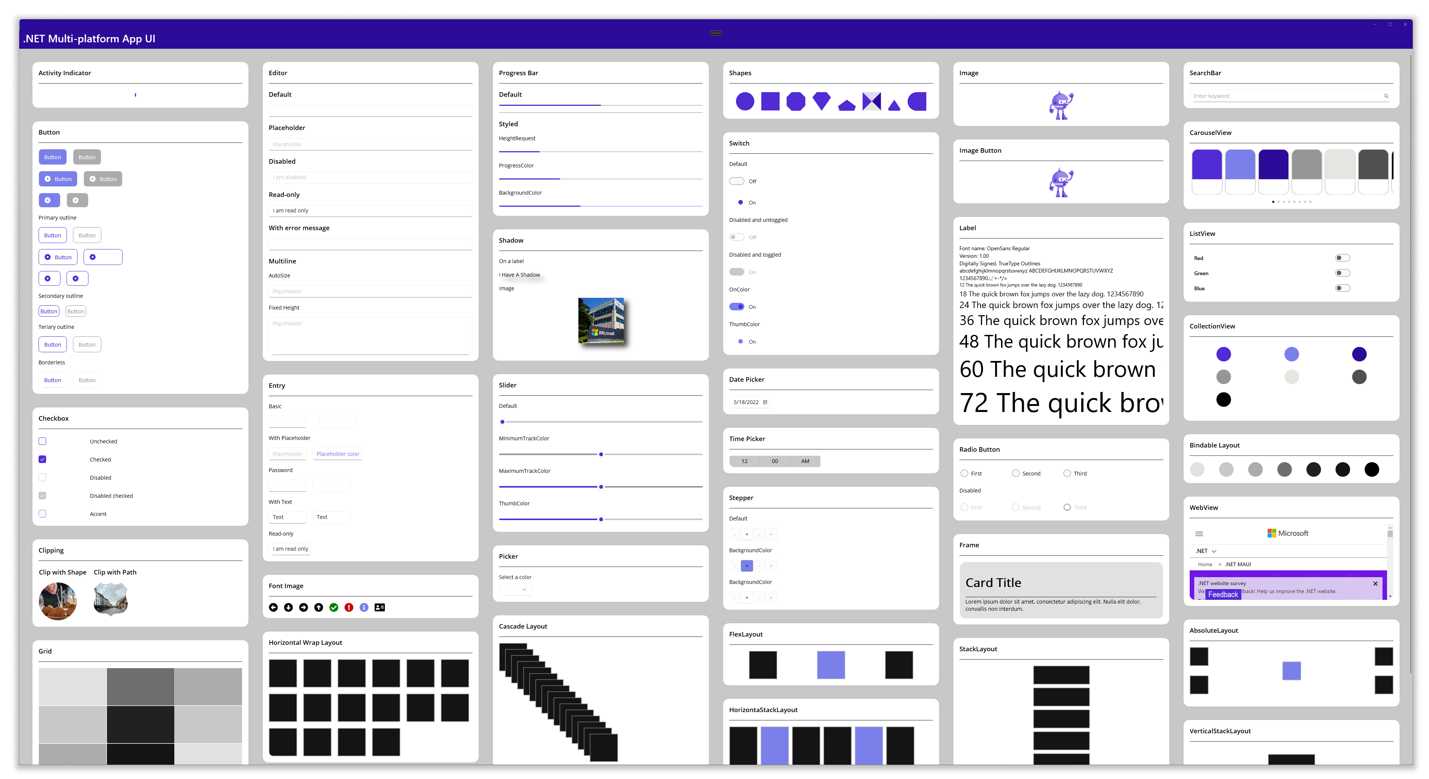

Slide 48
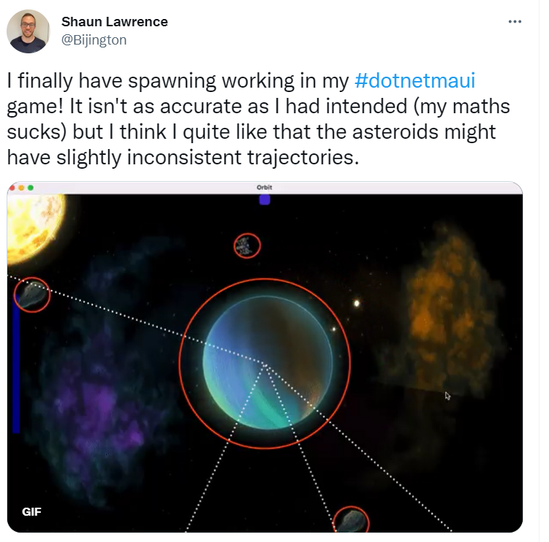

Slide 49
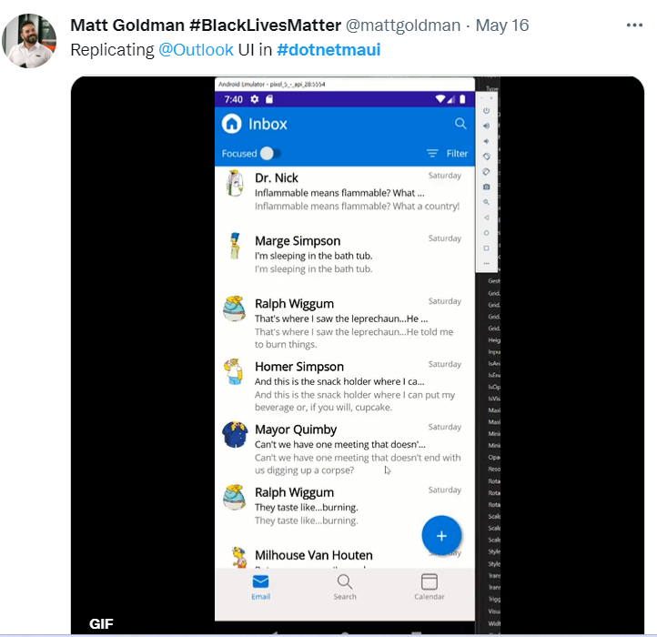

Slide 50
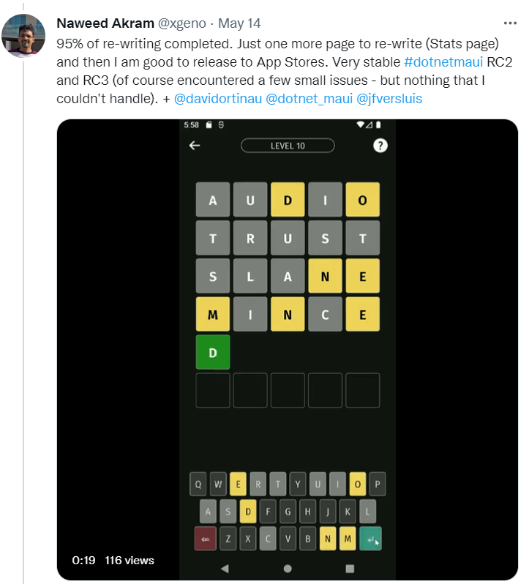

Slide 51
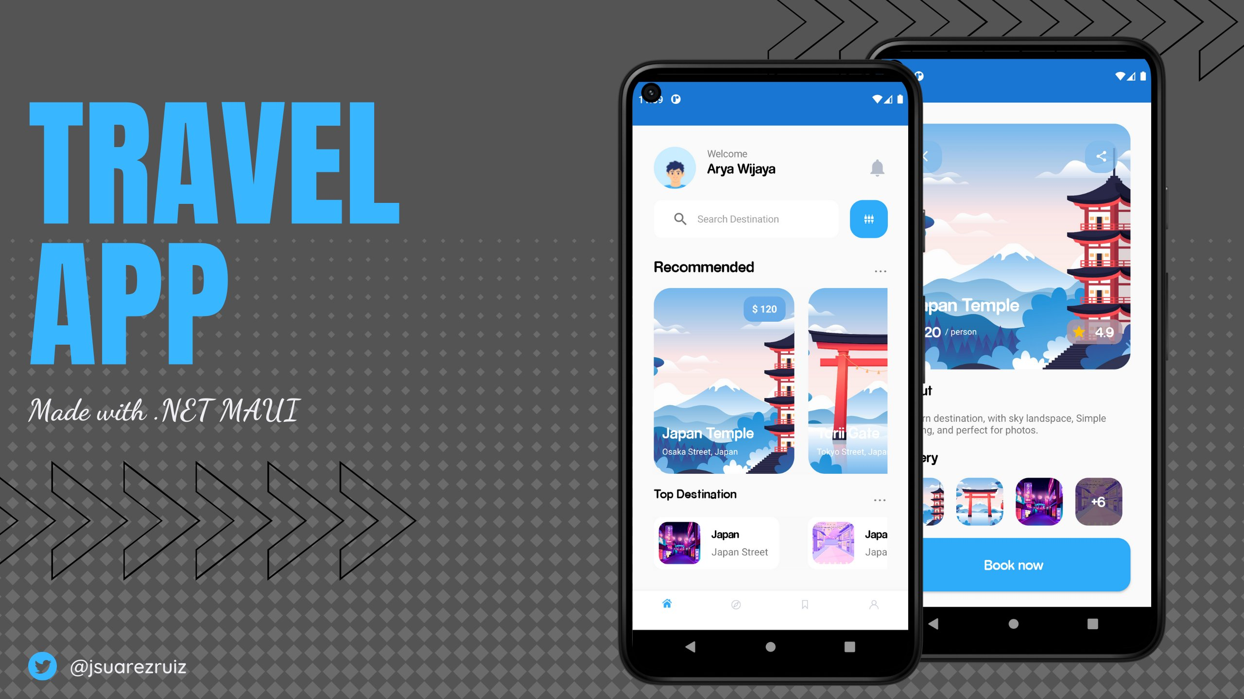

Slide 52
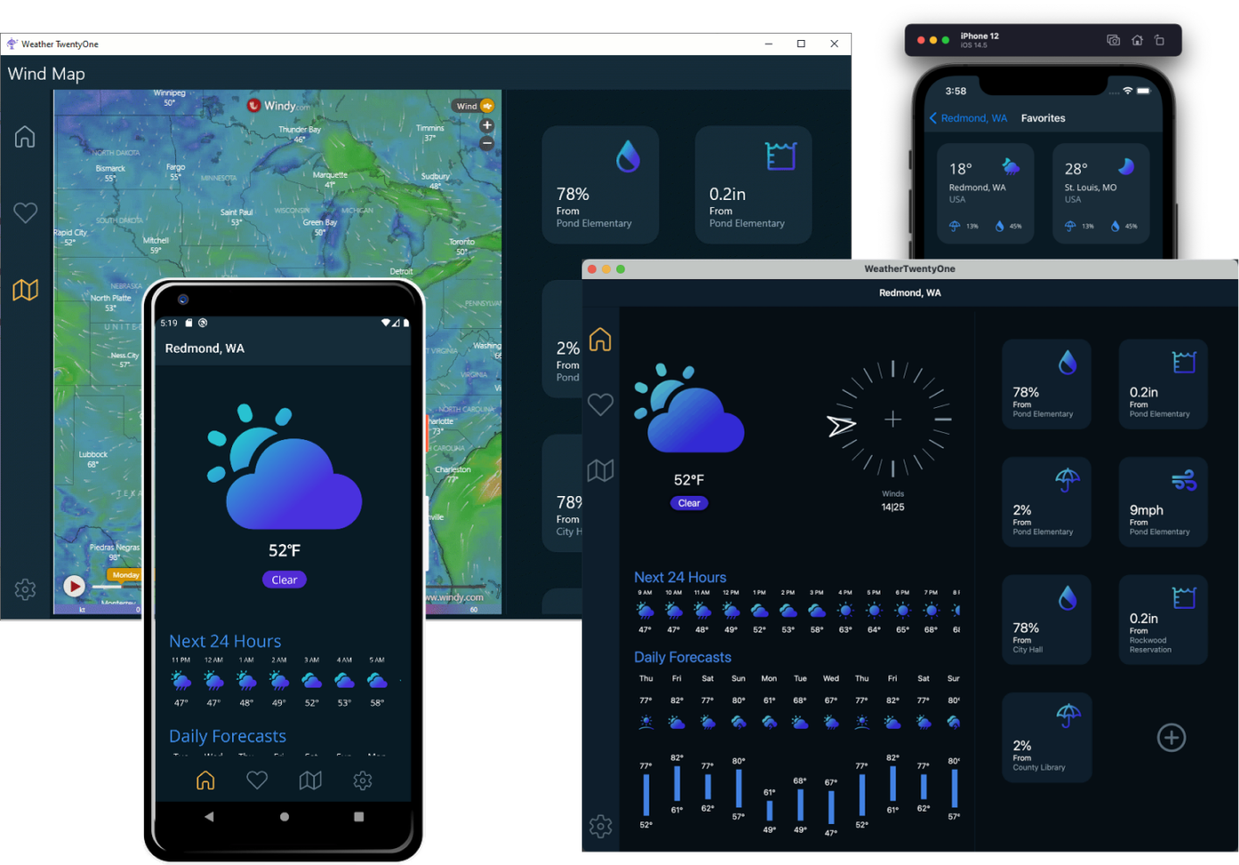

Slide 53
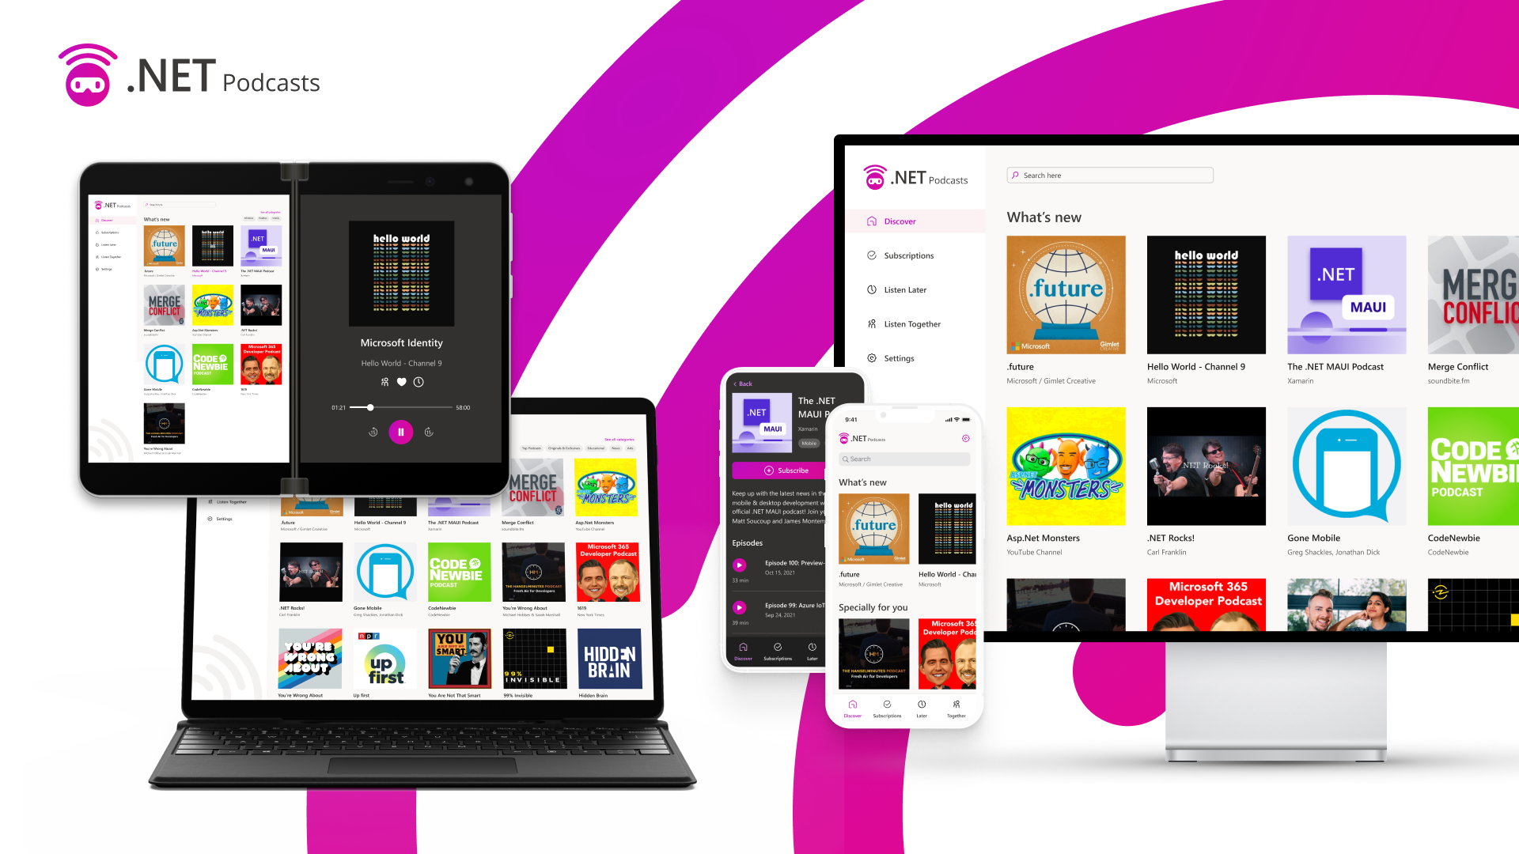

Slide 54
FAQs
Questions, worries, and the hunt for the cheese.

Slide 55
Should I use Xamarin.Forms now, or wait for .NET MAUI?
Xamarin.Forms. Your project will upgrade to .NET MAUI.

Slide 56
Will you migrate my solution to “Single Project”?
No, your existing projects will continue to work without Single Project. We will migrate projects in place to the .NET 6 common project system.
Documentation will be provided if you wish to manually adopt Single Project.

Slide 57
Do I need to rewrite custom renderers?
No. We are making sure the renderer pattern still work.
You may want to migrate them to the lighter handler pattern at your convenience.

Slide 58
Will 3rd party UI libraries continue to work?
Yes! At a minimum they will need to recompile adding a target for .NET 6.

Slide 59
Will .NET MAUI run on Linux?
Linux is not a supported platform in this version of .NET MAUI. There is an unofficial backend implemented with GTK.

Slide 60
What “flavor” of XAML will .NET MAUI use?
The same XAML you use in Xamarin.Forms today.

Slide 61
Where can I follow progress?
github.com/dotnet/maui

Slide 62

Thanks for joining !

